Slide 1
Communication Techniques

Slide 2
Syllabus
Course title: Communication Techniques
Nature of the course: Theory + Tutorial
Year: First Semester
Credits: 2
Full marks: 100
Pass marks: 45
Total periods: (30)

Slide 3
Unit 1: Thinking about audience, purpose, and genre
Users
Purpose
Genre

Slide 4
…
“As soon as you take one step up the career ladder your effectiveness depends on your ability to communicate your thoughts in writing and in speaking”.
-Peter Drucker

Slide 5
No matter how many technical skills you have, you still need to deal with people at a level they can understand, so communication skills are just as important as technical skills.
—Paula Anthony, Tech support team leader

Slide 6
What is communication?
Transfer of message from the sender/addressor to the receiver/addressee.
Exchange of information between the addresser and addressee.
Two directional information flow.
Social interaction through message.
Communication involves signs and codes.
Communication can be verbal or non-verbal
Communication can be internal or external.
Communication can take place in two people as well as in-group.
It is a dynamic process

Slide 7
Principles of Communication (7 Cs)
Clarity
Completeness
Conciseness
Concreteness
Consideration
Correctness
Courtesy

Slide 8
What is technical communication?
Process of creating, designing, and transmitting technical information so that people can understand it easily, safely, and efficiently.
Activity of preparing and publishing specialized information in a way that allows non-specialists to understand to accomplish the task.
Process of managing technical information in ways that allow people to take actions.

Slide 9
Examples
Computer manuals (print versions and help screens)
Assembly instructions for appliances, equipment, furniture, toys, and games
Research articles that present scientific or technological discoveries
Magazine articles that explain how to complete a process— preparing yellow chicken curry
Training films that demonstrate a process
Instructions on how to register online or create an online account

Slide 10
How does it differ from other types of writing?
All writing takes place in a specific context, and all writing involves these elements: a writer/speaker, a message, and a reader/listener.
Two of the main differences between technical communication and other types of communication are:
Its subject matter usually requires some type of specialized/ technical knowledge.
It bridges the gap between an expert and the lay or non-specialist reader to complete the action successfully.
Some people call technical communication “instrumental” because it works as an instrument or tool for people to get something done.

Slide 11
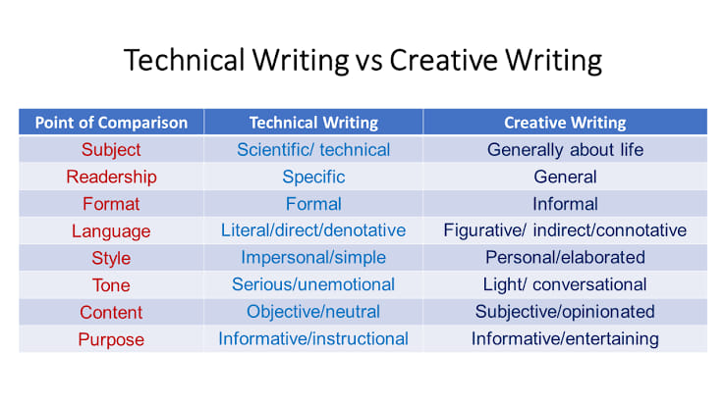

Slide 12
Models of communication

Slide 13
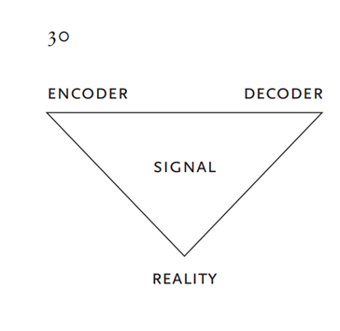
James L. Kinneavy’s communication triangle
This model shows one way to think about the relationship between writer, reader, and text in any kind of writing.
In this diagram, reality forms a third point on the triangle, which shapes the relationship between the writer (encoder), the reader (decoder), and the text or document (signal).
In technical communication, the text represents a kind of reality prepared by the writer for the reader.
Each type of writing focuses on a different aspect of the triangle (expressive, persuasive, literary etc.)

Slide 14
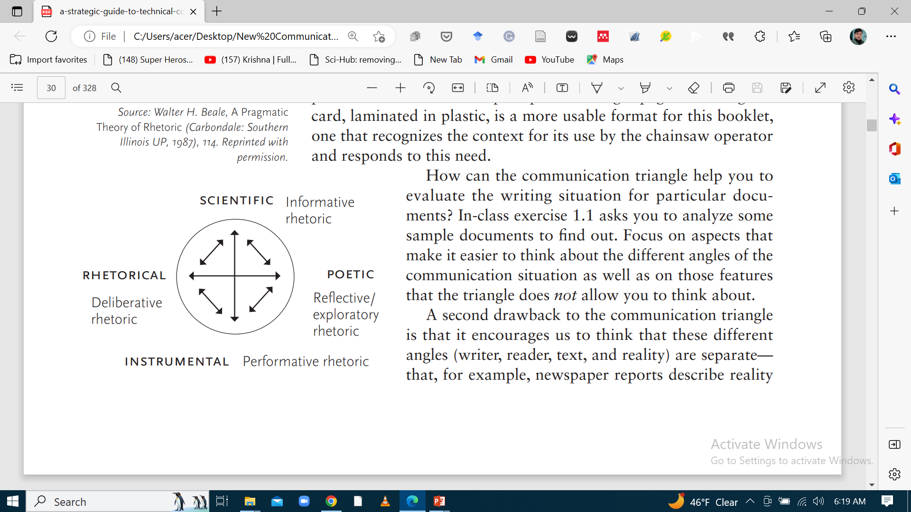
Walter H. Beale’s model of communication
Beale discusses the purpose or aim of different types of writing.
He aims to highlight the relationships created between the writer, the reader, reality, and the text in each type of writing. For example, poetic writing (or discourse) relates to the writer and enables the writer’s self-expression or self-exploration.
Poetic (or literary) discourse explores writers’ personal visions.- poems, Novels
Instrumental discourse links readers and reality: they provide information to help readers perform a particular action. – user manual
Rhetorical discourse aims to persuade readers—to change their minds about a particular issue or belief (or at least swift them to consider the writer’s viewpoint, even briefly). –political speech
Scientific discourse seeks to relate readers to reality by informing and educating readers about complex technical ideas.- Research article

Slide 15
Document analysis
In-class exercise 1.1
Applying the Communication Triangle to Sample Documents
Assemble a collection of print documents, some that are examples of technical communication and others that are examples of professional or business communication.
For example:
The user’s manual for an appliance such as a cd player
A flyer that arrived in your junk mail recently
The installation guide that came with the mini-blinds (or other diy product)
A brochure that you picked up in the grocery store or the doctor’s office
A letter from a non-profit organization asking for donations
The bill from your cell phone or land line

Slide 16
…
Now, analyze your collection of documents individually from the perspective of the communication triangle:
Who is the writer?
Who is the intended reader?
What are the purposes of the document?
What form does the document take?
In what way does the content of the document represent reality?
What characteristics do these documents share?
What limitations do you see to the communication triangle as you seek to apply it to the selection of documents that you collected?

Slide 17
In- class exercise 1.2
Analyzing Documents with Multiple Aims
Assemble a second collection of documents that includes a broader range of sample documents: add a short story or poem, as well as a newspaper article; a magazine article; a set of instructions; a business letter ; some advertising fliers or brochures; a scientific report, a magazine or newspaper editorial; a business form, questionnaire, or bill.
Study these different types of documents from the perspective of Beale’s model, illustrated in Figure 1.2.
What is the main purpose or aim (i.e., rhetorical, scientific, poetic, or instrumental) of the document?
What kinds of secondary aims does it have?
Which other categories might it also fit well into?
How easy is it to assign a primary category to each document?
What kinds of documents make it difficult to determine a primary aim or purpose?

Slide 18
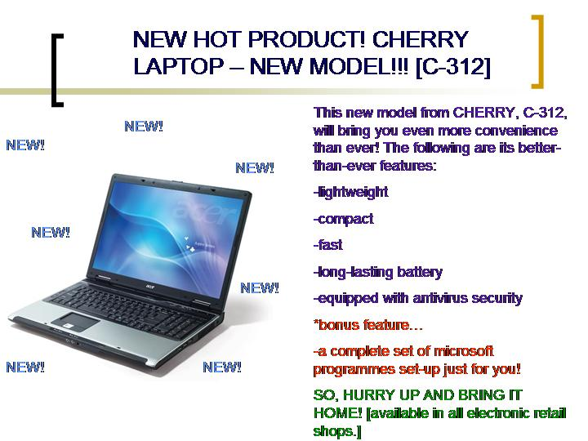

Slide 19


Slide 20
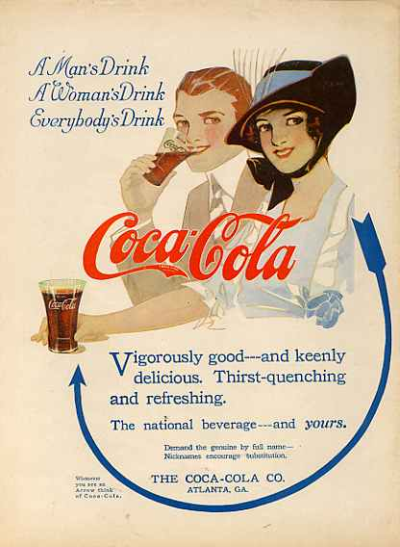

Slide 21


Slide 22
Users
Users are active participants in the performance of the technical communication text.
They are much closer to the actors’ role than the audience’s role because they make the writer’s words live by using them to do something, instead of just passively observing.
Readers judge competency and intelligence of writer based on the documents
The challenge for technical writers: how to learn what users already know and what they need to know—and how to provide what they need to know for them where and when they need it.

Slide 23
Ways of thinking about users/ types of users
Primary audience: Your primary audience is the major group of users who will use your instructions.
Secondary audience: Rather than following step-by-step through your instructions, he or she may skim/scan the guide, noticing forgotten details.
He/ she uses it as a reference, not a how-to document.
These secondary users have a different level of knowledge than do your primary users, but they may still consult your guide.

Slide 24
…
Initial audience: When you are first assigned the project, your boss (or, in class, your instructor) becomes an initial audience—who will approve your project, whether or not your guide reaches to the primary audience.
Gatekeeper audience: A supervisor higher up in the organization who will give final approval on your guide, decides whether to publish it.
Gives feedback about how the guide should contribute to the organization’s image, that could result in revisions to its style or arrangement.
Watchdog audience: Might be a government or regulatory organization not connected with you directly but reviews the products that your organization creates.

Slide 25
How do you learn about your users?
Take an inventory (record) of what you know about your target user group
Create a profile to distinguish target user from other types of users
Interview individuals who fit into your user profile
Observe individuals who fit into your profile using similar types of documents
Analyze earlier forms of the document to assess how the user was considered there to note changes, useful strategies, and gaps with your profile

Slide 26
To build an inventory of the characteristics consider these factors:
Level of experience with the subject matter
Educational background, both generally and specifically, as related to your topic
Experience and attitude towards learning new things, technology generally and your topic specifically
Relevant demographic characteristics such as age, sex, race, socio-economic background or class, culture, language etc.

Slide 27
Class exercise 1.3
Analyzing Multiple Audiences for Documents
To help you imagine how these five categories of audience might respond in different ways to a single document, think about all the different people who might come in contact with a résumé you send as part of your application to a particular position.
Of the individuals who look at your résumé as it moves through the organization,
which category would each person fit into?
What would each person think about or be interested in as he or she reads your résumé?
Of these different readers, which would have the most and the least authority to offer you an interview?
After thinking about who will see your résumé and for what purpose, what changes might you make to your résumé to reach these different audiences more effectively?

Slide 28
Do some research
Interview users
Observe users
Interview experts
Create user profiles

Slide 29
Purpose: Why are you writing?
Another essential component of the writing situation, besides audience, is purpose or aim: what do you hope to achieve through creating your document?
You may have one main purpose or several important goals that you want your user to understand after reading your document.
Eg; in a memo to coworkers, you might want them to learn that they have one month to review their benefits selections and make any changes they want.

Slide 30
…
Eg; the goal of your memo will be fourfold:
1. To get them to read your memo and understand it;
2. To persuade them to review the attached booklet (or visit the informational web page) that outlines their possible choices;
3. To motivate them to visit the website (or review the attached form) and make any changes they want
4. To do all this before the deadline (e.g., March 31).

Slide 31
…
One goal that often characterizes technical documentation is education, its primary purpose is to instruct the reader or user.
Although instruction may be the primary goal of many technical documents, most texts will also have secondary goals: to inform, to satisfy, to please, to persuade etc.
Technical documents that instruct users quickly and painlessly in how to accomplish the tasks using the associated product can only foster goodwill, increasing users’ desires to try the company’s other products based on the positive experience with this one.

Slide 32
In- class exercise 1.4
Write a User Profile
Write a user profile of yourself as a reader of this chapter.
Include whatever demographics you think are relevant, as well as personal characteristics that affect your reading and reception of the information in this chapter.
sample profiles
Gina: 50-year-old administrative assistant, in history in 1992; self-taught software programs including Word, PowerPoint®, and Excel®; makes minor changes to department’s web pages on Internet to update announcements, etc.; basic user of Dreamweaver® but eager to learn more Ambitious and not afraid of technology.
Karl: 27-year-old financial analyst, bamba in 2011; proficient user of various web-based software; owns a small consulting firm supported by website; paid consultant to develop website for him two years ago, but now needs to update it; wants to do this himself. Novice user of Dreamweaver®; concerned about whether he can make the changes that he needs to by himself.

Slide 33
Lab Assignment 1.1
characterizing your users
Choose your own favorite website and explore these sites. Using the questions that follow, try to figure out what assumptions the content developers are making about their users’ needs. See if you can develop a profile of the type of user that each of the websites addresses through its content and presentation.
a. http://www.tms.org/ b. http://www.useit.com c. http://www.marijuana.org
d. http://www.guinness e. http://whitehouse.gov/kids f. http://www.royal.gov.uk
Generating Ideas for Your Profile
Who is visiting this website?
What special characteristics do they have?
What is their background in the subject matter?
What attitude toward or level of interest do the site designers assume the user has in the subject?
Why do you think users will come to this website?
What tasks might users perform based on the information in this website?
What legal issues did the website designers have to address regarding this subject matter?
Is the content of the website directed at a cross-cultural audience? How can you tell?
What level of technical knowledge does the website assume in the reader/user? How can you tell?

Slide 34
What is Genre?
The word “genre” was originally a descriptive term classifying documents into groups such as résumé, technical report, or user manual.
For Anis Bawarshi (2003) genre as “typified rhetorical strategies communicants use to recognize, organize, and act in all kinds of situations.”
Genres are used to accomplish actions, and by selecting one genre over another, writers convey specific information that immediately helps readers to understand the purpose of the document.
A genre is based on structural and rhetorical conventions, the organization and presentation of content, and the goals and function.

Slide 35
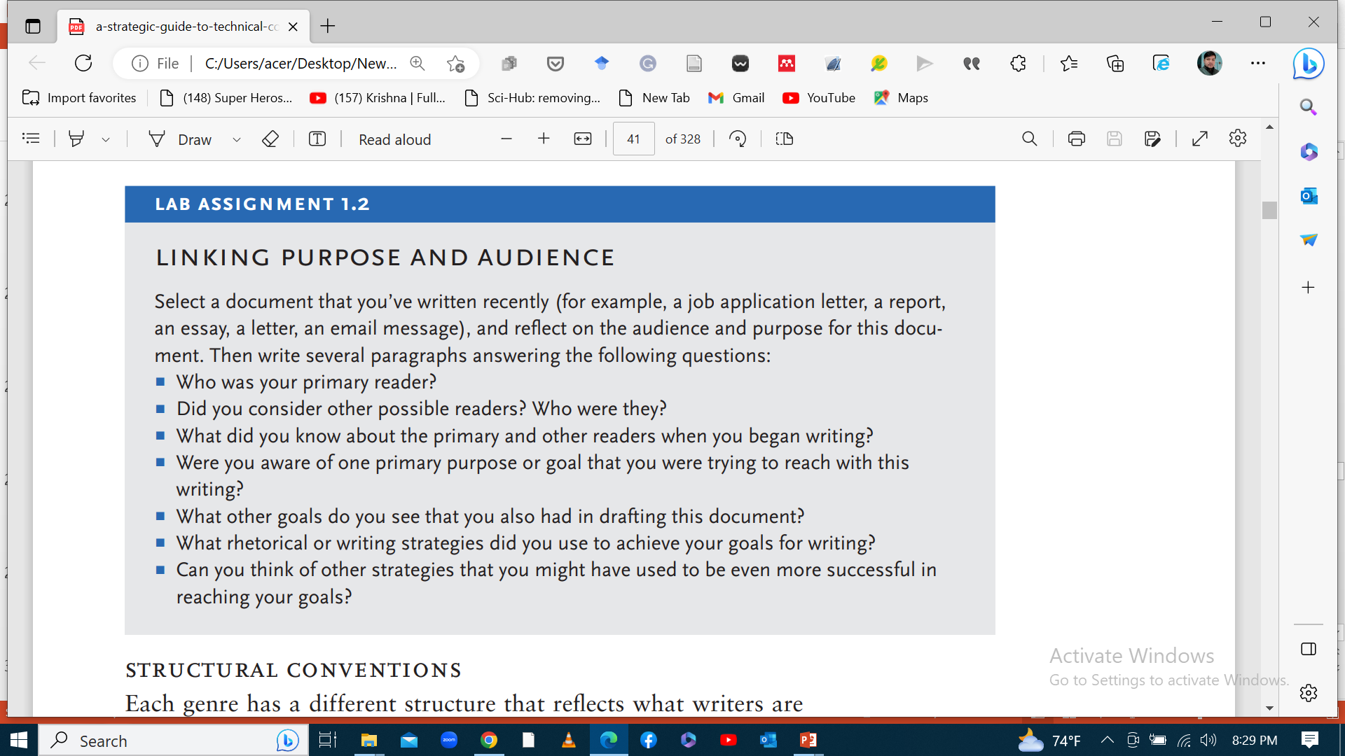

Slide 36
Main genres of technical communication
Procedures or instructions
Manuals
Reports on technical subject matter
Specifications
Proposals
Letters
Memos
Oral presentation

Slide 37
Why does genre matter?
To be considered an educated and experienced professional in your field, you need to know about and be able to produce the principal genres of your field.
If you understand the conventions of the genres that you need to write and you have learnt to meet those conventions effectively, you will be considered a “good” ( even the best) writer of technical communication.
If you understand and can use the conventions of a genre, you can focus on the writing itself, making the content and presentation more effective.
Understanding the basic generic conventions of how to structure instructions helps you to focus on the process of creating the text.

Slide 38
How does one analyze a new genre?
Style
2. Structure
3. Register

Slide 39
…
Style includes elements such as sentence length, kind, and complexity; word choice, use of figurative language such as metaphors.
Structure refers to how information or content in a document or genre is organized
is it subdivided into sections?
How long is each section?
What type of content appears in each section?
Register refers to the level of language used in the genre.
Is it casual, informal, or formal?
Does it use contractions (an indication of informality)? Does it use “I”?

Slide 40
Lab assignment 1.3: analyzing a new genre
Select two sample documents from a genre that you have never written before.
Apply the process of analysis outlined in this chapter to four or five paragraphs from the two samples. When you have completed analyzing the prose style, write a memo reporting what your major conclusions are about the principal features of this genre.
Address the memo to your classmates to help them understand quickly the distinguishing characteristics of the genre that you analyzed.

Slide 41
What are genre sets?
“Genre sets” are groups of documents that go together.
For example, if a software development firm publishes a request for proposals (RFP) to document a new program developed by their engineers, you, as an independent technical communicator, may respond with a proposal outlining your plan to create the manuals for the project.
The RFP, the proposals that are written in response, and the documents that are created as a solution to the problem outlined in the RFP all make up a “genre set.”
Similarly, if you respond to a job advertisement with an application letter and résumé, you create another genre set.
The interrelation of these documents constitutes some of the important activities of a business organization.

Slide 42
Structural Conventions
Each genre has a different structure that reflects what writers are trying to accomplish in using that particular genre.
When readers see the structural elements of a particular genre, they antedate the specific content associated with that genre structure before they begin reading.
If the content does not match reader expectations based on the genre structure (the visual organization of the text), they will be confused (and perhaps annoyed).

Slide 43
Rhetorical conventions
Each genre also has rhetorical conventions—that is, expected purposes or aims that the type of document will accomplish.
A writer would never choose to present a business activity update in the form of a technical manual. Nor would a reader consult a manual to gain an activity update. Nor would a manager expect to find a set of instructions on creating rich text format in a subordinate’s activity report on her monthly accomplishments.
Readers have expectations about the rhetorical purpose of a genre as well as about its structure. If a document does not meet its anticipated rhetorical conventions, it is a poor sample of that genre.

Slide 44
Organization and presentation of content
Not only genres have structural and rhetorical conventions, they also have rules about how to organize and present the content they contain.
They should meet reader and industry expectations, about presenting the content that readers expect in the order that they expect it for a given genre.
The way the content or information is presented differs from one genre to another.
We should use a genre’s conventions to present information where and how readers expect it.

Slide 45
Goals and function of the genre
Each genre has a specific goal (or series of goals) and a function.
In the workplace, genres generally aim to facilitate an activity or the promotion of a product.
In contrast, academic genres generally have the goal of demonstration of achievement: they demonstrate learning of a subject matter and knowledge competence.
Workplace genres do not have a central goal of the demonstration of writer’s competence. Rather to achieve action, either by consumers or employees.
Similarly, a genre such as the job application functions as a source of information and argument: writers detail their qualifications for a particular job opening and show readers how they are superior to other applicants for this position.

Slide 46
Genre and activity sets
One way to understand the role that genre plays in workplace, academic, and other types of writing is to consider the activities of an organization centered around writing.
For example, in education, the goal is focused on taking courses, reading books and articles, listening to lectures, working on problems, and participating in discussions about the information you’ve learned through reading, listening, and thinking.

Slide 47
…
Workplaces resemble educational institutions are also activity based, and many of the business activities, either of a technical communicator, manager, engineer, or lab technician, take place through writing.
To contribute to the documents that ground an organization’s activities, you need to understand the main genre categories that represent the work being done.

